Slide 1
Nx library
An introduction (by Ohhi.vn)

Slide 2
Agenda
Introduce about Ohhi.vn & me.
What is Nx library?
Some libraries for working with ML/DL.
Demo.
Q & A.

Slide 3
Ohhi.vn
Started from 2023.
Came from Erlang’s world.
Focus to Elixir ecosystem.
Have some open source projects (https://github.com/ohhi-vn).
Try to make new funny thing for people.

Slide 4
About me
Experience:
Worked in security field in many years (CMC CyberSecurity, VinCSS).
Design & build SoC(log collecting & analysis - A kind of big data) from scratch for big corp.
Develop antivirus & security product (leader & main contributor).
Things are made by me:
CMC CryptoSHIELD (detect & protect pc out of ransomware).
High Performance rule based detection engine for SoC.
Now
Interested in functional programing then go to work full time on Elixir/Erlang.

Slide 5
What is Nx (Numerical Elixir) lib?
A library for working with numerical & manipulating multidimensional data in Elixir.
Easy to work with matrix & vectors.
A foundation for other libraries to applied Machine Learning/ Deep Learning (ML/DL) to Elixir.
(In Python’s world we have NumPy, in Elixir we have Nx)

Slide 6
Nx - Main things
Tensor, a data type in Nx, hold data in multiple dimensions.
Operators for manipulating tensors: Nx.add, Nx.multiply, Nx.sum,...
defn for define expression of math formulas.
Backend, where for data processing.

Slide 7
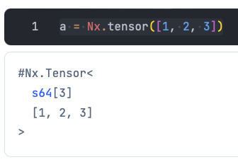
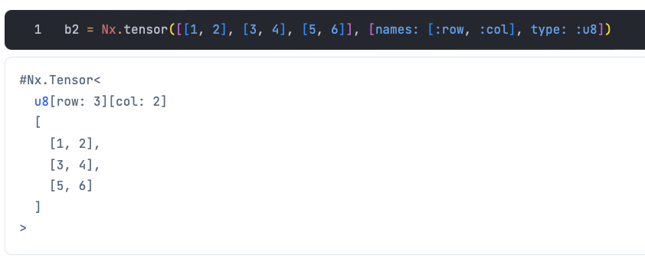
Nx - Tensor
Data in Nx is number (integer, float, brain float, complex) and tensor hold it in one or multidimensional arrays.
Tensor can hold scalar(0 Dimension), vector(1 D), matrix(2 D), nd-array(n D) (mathematics name).

Slide 8
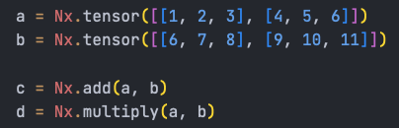
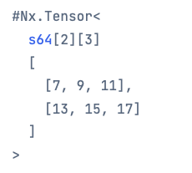
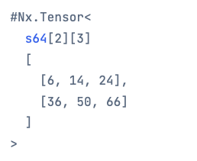
Nx - Operators
Operator groups: Aggregating, Window, Cumulative,...
Nx operators can understand tensor and run faster than regular Elixir.

Slide 9
Nx - defn/defnp
A macro to wrap an expression of math formulas.
Very convenience for working with tensors.
Tensor ware, replace common operators in Kernel module (like: ‘Kernel.-/2) by Nx Operators (optimized for tensors).
Compile from AST to target backend when function is called.
Code in defn/defnp can only call function that define by defn/defnp. Use deftransform/deftransformp if you want to invoke code is not define by defn/defnp
defn/defnp are defined in Nx.Defn module we need import for using.

Slide 10
Nx - Backends
Where the data will be processed.
Computing run on CPU, GPU, TPU,... Depended backend we used.
Some kind of backends:
- BinaryBackend (default backend), a pure Elixir implementation. Slow but can run everywhere & can validate.
- EXLA, Elixir client for XLA (Accelerated Linear Algebra - from Google).
- TorchX, Elixir client for Torch Script (PyTorch, from Meta).
Nx support third party backends (means we can develop own backend).

Slide 11
Nx - Foundation for ML & DL
Axon: Creating and training neutral networks.
Scholars: Traditional ML.
Bumblebee: Easy to pull & run model from Hugging Face (AI community).

Slide 12
Axon - Intro
Pure Elixir interface for deep learning.
Build on top of Nx, don’t need too much work to create, train & run a model.
Can run model with ONNX (Open Neural Network Exchange) format through AxonOnnx.

Slide 13
Bumblebee - Intro
A wrapper of Axon.
A very convenience library for load & run model from Hugging Face.
Can run on LiveBook.

Slide 14
Demo
Some basic examples run on LiveBook for easy understand Nx & libraries.

Slide 15
Benefits of Nx & libs
We don’t need go out to learn other languages/tools to develop ML/DL
We can run directly inside Elixir app and reduce latency.
Easy to develop, integrate & deploy ML/DL with our Elixir apps.
Save time & resource to develop product.
(You can work (solo) from frontend to AI - An advantage stack)

Slide 16
Other libraries for working with Nx
Explorer, for ETL (extract, transform, load) task.
Scidata, data samples for study.
Evision, a wrapper OpenCV.

Slide 17
Recommended docs
Sean Moriarity’s blog https://seanmoriaty.com
Sean Moriarity’s book Machine Learning in Elixir (on The Pragmatic Bookshelf).
Deep dive in Nx Backends (Paulo Valente) on Youtube.
Comparing Elixir and Python (A. Neto & L. C.) on Youtube.

Slide 18
Q & A
Thank you for listening!
Time for Q & A.

